Slide 1

HELLO!
Here 1Crore Projects
I am here because I love to give presentations.
You can find me at @1CROREPROJECTS

Slide 2
Dual-Server Public-Key Authenticated Encryption with Keyword Search

Slide 3

AIM OF PROJECT
The main aim of the project is, searchable encryption technique provides a secure storage method without loss of data confidentiality and usability.

Slide 4
ABSTRACT
In cloud storage, how to search sensitive data efficiently and securely is a challenging problem. The searchable encryption technique provides a secure storage method without loss of data confidentiality and usability. As an important branch of searchable encryption, public-key encryption with keyword search (PEKS) is widely studied by scholars.
However, most of the traditional PEKS schemes are vulnerable to the inside keyword guessing attack (IKGA). Resisting the inside keyword guessing attack is likely to become an essential property of all new PEKS schemes.

Slide 5
INTRODUCTION
Cloud storage has become a promising paradigm with the explosive growth of data in recent years. It not only provides an on-demand storage service for users, but also facilitates users’ access to data. However, data outsourced to cloud server may contain some sensitive information (e.g., company financial data, health records), which may incur security and privacy issues. To protect data confidentiality, one general approach is to encrypt the data before transferring it to the cloud server. But the encrypted data makes its utilization more difficult, particularly the ability of data retrieval.

Slide 6
EXISTING SYSTEM
In existing system of the project is a long time, mitigating IKGA has been inefficient and difficult, and most existing PEKS schemes fail in achieving their security goals.
We first give a theoretical analysis of the performance of DPAEKS by comparing it with the existing system where the works and are recent research efforts that resulted in better performance to resist IKGA under the different frameworks the single-server framework and the dual-server framework.
PEKS schemes is the time costs of the encryption algorithm and the test algorithm are both linear with the number of keywords.

Slide 7
DISADVANTAGES:
Low search accuracy
Low search efficiency
Key leakage

Slide 8
PROPOSED SYSTEM
The proposed system can prevent the malicious server from guessing the keywords which are queried by the data user. On the other hand, our scheme can efficiently protect the data receiver’s privacy.
We define the notion of dual-server public-key authenticated encryption with keyword search. We present a concrete construction of DPAEKS without bilinear pairing operation, and prove its security under the decisional Diffie-Hellman (DDH) assumption.
We implement our scheme and compare its performance with previous works, and evaluate it on a real-world dataset.

Slide 9
ADVANTAGES:
High search accuracy & performance
High search efficiency.
Limited key leakage.

Slide 10
ALGORITHM
ABE
Attribute-based encryption (ABE) can be used for log encryption. Instead of encrypting each part of a log with the keys of all recipients, it is possible to encrypt the log only with attributes which match recipients' attributes.

Slide 11
Cipher text:
Cipher text is also known as encrypted or encoded information because it contains a form of the original plaintext that is unreadable by a human or computer without the proper cipher to decrypt it. Decryption, the inverse of encryption, is the process of turning cipher text into readable plaintext.

Slide 12
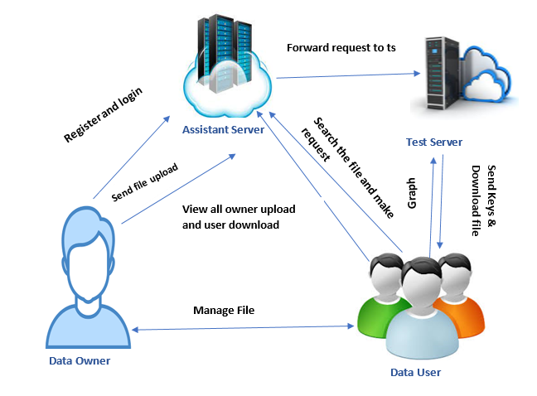
SYSTEM ARCHITECTURE

Slide 13
MODULES
In this project has four Modules:
Data Owner
Data user
Assistant server
Test Server

Slide 14
MODULES DESCRIPTIONS:
Data Owner:
Register the account with the basic information.
After authorize by AS then login with correct username and password.
Send file upload request to the As accepted means owner can upload the file with the encrypted format with the file keyword
Manage the file
Logout

Slide 15
MODULES DESCRIPTIONS:
Data User:
Register the account with the basic information.
After authorize by AS then login with correct username and password.
View and Make a request for file download to As.
Assistant server accepts the request and forward request to ts, the ts accept and share the File Key & Download the file
Logout

Slide 16
MODULES DESCRIPTIONS:
Assistant server:
Login the account with the correct credentials
View all owner and user can be Authorized both them.
View owner upload request.
View user download request, accepted and sent to TS
View all uploaded file
Logout

Slide 17
MODULES DESCRIPTIONS:
Test server
Login the account with correct credentials
Once the AS accepted owner can upload the file.
Once the AS accepted ,then forward to TS accept the request and send the key for Download
View all uploaded files and downloaded file.
Graph
Logout

Slide 18
SOFTWARE REQUIREMENTS
System | Intel i3 and above
Hard Disk | 40GB
RAM | Minimum 4GB
Processor | 64-bit, four-core, 2.5 GHz minimum per core

Slide 19
HARDWARE REQUIREMENTS
Front End Language | HTML, CSS, JAVA, JSP SERVELTS
Backend | My SQL
Operating System | Windows 10 or 11
IDE | JAVA DEVELOPEMENT KIT

Slide 20
FUTURE WORK:
In our future work the features of DPAEKS include: two non-colluding servers that are used to protect against IKGA and the data owner should be distributed with a pair of keys to authenticate the data. We developed a concrete construction of DPAEKS and proved its more security.

Slide 21
CONCLUSION
In this project , Combining protection against IKGA and efficiency is not trivial because the two properties are irreconcilable. In this paper, we have presented a new scheme called dual-server public key authenticated encryption with keyword search (DPAEKS).
The features of DPAEKS include: two non-colluding servers that are used to protect against IKGA and the data owner should be distributed with a pair of keys to authenticate the data. We developed a concrete construction of DPAEKS and proved its security. Finally, we implemented and evaluated the performance of the proposed scheme. The empirical results we obtained demonstrate that it is suitable for deployment in practical applications.

Slide 22
REFERENCE
[1] D. X. Song, D. Wagner, and A. Perrig, “Practical techniques for searches on encrypted data,” in Security and Privacy, 2000. S&P 2000. Proceedings. 2000 IEEE Symposium on. IEEE, 2000, pp. 44–55.
[2] D. Boneh, G. Di Crescenzo, R. Ostrovsky, and G. Persiano, “Public key encryption with keyword search,” in Eurocrypt, vol. 3027. Springer, 2004, pp. 506–522.
[3] P. Xu, H. Jin, Q. Wu, and W. Wang, “Public-key encryption with fuzzy keyword search: A provably secure scheme under keyword guessing attack,” IEEE Transactions on computers, vol. 62, no. 11, pp. 2266– 2277, 2013.

Slide 23
THANKS!
Any questions?
You can find me at
Reach us – 1croreprojects@gmail.com
Contact / Whatsapp: 7708 150 152 / 9751 800 789 / 790 432 0834

